Slide 1
The Minimum Connectivity of Graphs with a Given Degree Sequence
3rd Annual Mississippi Discrete Mathematics Workshop, Mississippi State University
Rupei Xu
UT Dallas
Joint work with Andras Farago

Slide 2
Rupei Xu
Andras Farago

Slide 3
Interdisciplinary Communication
Operations
Research
Computer Science
Mathematics

Slide 4
Motivation 1: Big Data Era
Degree Distribution=
Primary + Least Expensive Metric Data

Slide 5
Motivation 2: What Can Degree Sequences Tell Us?
Enumeration of graphs
Read (58), Read & W (80), Goulden, Jackson & Reilly (83), W (78, 81)
Bollobás (79, 80), McKay (85), McKay & W (91), Gao & W(2014)
Giant component
Molly &Reed (95, 98), Chung & Lu(02, 06), Janson & Luczak (09)
Random graph Bollobás (79, 80), Aiello, Chung &Lu(00), Newman, Strogatz & Watts(01)
Average distance/Mixing pattern Newman(02, 03), Chung & Lu(02, 04),
Percolation Fountoulakis(07), Janson(08), Amini(10), Bollobás(10)
etc. …

Slide 6
Motivation 3: Applications
Network Reliability
Network Security

Slide 7
Origin
Cayley (1874)
Looking at saturation hydrocarbons considered the problem of enumerating the realizations of sequences of the form $(4^{x}, 1^{2x+2})$.

Slide 8
Question 1: Is this degree sequence graphical?

Slide 9
Question 2: Are the graphs formed by the degree sequence unique?
Hammer, Simeone(1981), Tyshkevich, Melnikow and Kotov(1980,1981):
Let $G$ be a graph with degree sequence $d_{1}≥d_{2}≥…≥d_{n}$ and $ω=max\{i:d_{i}≥i−1\}$. Then $G$ is a split graph if and only if $\sum_{i=1}^{ω}{d_{i}}=ω\left(ω−1\right)+\sum_{i=ω+1}^{n}{d_{i}}$.
If $G$ is a split graph, then every graph with the same degree sequence as $G$ is a split graph as well.
However, split graph does not determine the graph up to isomorphism.

Slide 10
$G$ is a unigraph if $G$ is determined by its degree sequence up to isomorphism, i.e., if a graph $H$ has the same degree sequence as $G$ , then $H$ is isomorphic to $G$.
In graph theory, a threshold graph is a graph that can be constructed from a one-vertex graph by repeated applications of the following two operations: Addition of a single isolated vertex to the graph. Addition of a single dominating vertex to the graph, i.e. a single vertex that is connected to all other vertices.
Threshold graphs are unigraphs.
Hammer, Ibaraki, Simeone(1978) $G$ is a threshold graph if and only if equality holds in each of the Erdös-Gallai inequalities.

Slide 11
If a degree sequence is graphical (Erdös-Gallai Theorem) and equality holds in each of the Erdös-Gallai inequalities, can we say something about the connectivity of the graphs formed?
Counter example

Slide 12
Related Results
* Edmonds (1964)

Slide 13
Senior & Hakimi (1951,1962): Let $δ=\{d_{0}, d_{1},..d_{n−1}\}$ be a given realized set of integers with $d_{i}≤d_{i+1}$ for $i=0,1,…,n−2.$ Then, $δ$ is realizable as 1-connected graph if and only if $d_{0}≥1$ and $s\left(δ\right)=\sum_{i=0}^{n−1}{d_{i}}≥2(n−1)$.
Hakimi(1962): Let $δ=\{d_{0}, d_{1},..d_{n−1}\}$ be a given realized set of integers with $d_{i}≤d_{i+1}$ for $i=0,1,…,n−2.$ Then, $δ$ is realizable as 2-connected graph if and only if ${n>2, d}_{0}≥2$ and $s\left(δ\right)=\sum_{i=0}^{n−1}{d_{i}}≥2d_{n−1}+2(n−2)$.

Slide 14
Wang & Kleitman (1973)

Slide 15
How to realize?
The Layoff Procedure of Havel-Hakimi

Slide 16
Wang & Kleitman (1973)

Slide 17
Theorem: There is a $O(\operatorname{nmlog}{n})$ time algorithm to find the minimum connectivity of graphs for a given degree sequence.

Slide 18
Minimal Connectivity
A k-connected graph such that deleting any edge/deleting any vertex/contracting any edge results in a graph which is not k-connected is called minimally/critically/contraction-critically k-connected.

Slide 19
Focus on PATH!

Slide 20
Open Problem: with More Constraints
Given integers $n$, $δ$, $κ$ and $λ$, is there a graph $G$ of order $n$ such that $δ\left(G\right)=δ$, $κ\left(G\right)=κ$ and $λ\left(G\right)=λ$?

Slide 21
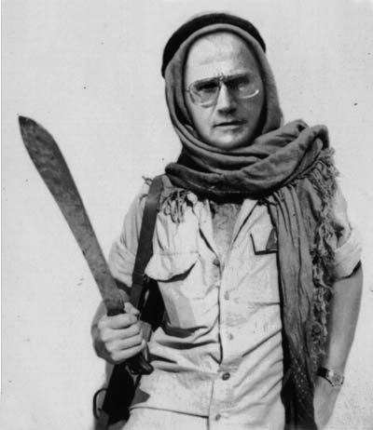
It is NOT open!
Page 4, Theorem 1.5

Slide 22
Open Problem: with More Constraints
Given a degree sequence and integers $n$, $δ$, $κ$ and $λ$, is there a graph $G$ of order $n$ with such degree sequence such that $δ\left(G\right)=δ$, $κ\left(G\right)=κ$ and $λ\left(G\right)=λ$?
Given a degree sequence and integers $n$, $δ$, $κ$ and $λ$, is there a graph $G$ of order $n$ with such degree sequence such that $δ_{min}\left(G\right)=δ$, $κ_{min}\left(G\right)=κ$ and $λ_{min}\left(G\right)=λ$?

Slide 23
How about random graph?

Slide 25
Open Problem
How about the minimum connectivity for general degree distributions?

Slide 26
Acknowledgments
Joseph O'Rourke
Nick Wormald

